Slide 1

Atm transaction data analysis
in
Power bi
Project by:
Bharath Bommeeshwar K
Data Science Learner
PGPDS_Praxis Business School
(Aug2022-Apr2023)

Slide 2
PROJECT FRAMEWORK:
1.Business Understanding
Problem statement
Objective
2.Data Understanding
Data Collection
Meta data
3.Data Preparation
Loading dataset
Treating errors
Manipulating data tables
Relationship between tables
4.Framing Potential business questions
5.Dashboards creation
6.Presenting Insights
7.Recommendations

Slide 3
Problem statement:
1.Business Understanding
Wisabi Bank(Fictitious), a prominent financial institution operating in Nigeria, aims to enhance customer experience and optimize operational efficiency with its ATM. To achieve this goal, the bank has engaged you as an external consultant to conduct a data analytics project focused on analyzing its ATM transactions data. The project aims to uncover insights and provide actionable recommendations to improve customer experience and operational efficiency across its branches.

Slide 4
Objective:
The objective of this project is to analyze Wisabi Bank's customer demographics, transaction patterns across various locations, popular ATM services, and usage trends. The project aims to identify potential growth opportunities based on customer needs and transaction patterns, as well as optimize the bank's operations by pinpointing areas for improved efficiency.
The analysis and visualizations produced using Power BI will provide valuable insights and actionable recommendations to enhance Wisabi Bank's services and operations.

Slide 5
2.Data Understanding
Data Collection :
Typically, clients are responsible for providing the data for analysis in such scenarios. However, for the purpose of this project, the data is obtained from a designated Google Drive repository belonging to a data analyst trainer. This arrangement has been established to facilitate the learning process. The link for this project folder is provided at the end of this report.
Meta data: (5 Dimension & 5 Fact tables):
Column Name | Description
TransactionID | Unique identifier for each transaction in the database
TransactionStartDatetime | Datetime when the transaction started
TransactionEndDatetime | Datetime when the transaction was completed
Cardholder ID | Unique identifier for the cardholder performing the transaction

Slide 6
Location ID | Unique identifier for the location of the ATM where the transaction occurred
Transaction Type ID | Unique identifier for the type of transaction that was performed (e.g., withdrawal, savings, balance enquiry, transfer)
Transaction Amount | Amount of money involved in the transaction
Location ID | Unique identifier for the ATM location
Location Name | Name of the bank branch where the ATM is located
No of ATMs | Number of ATMs
City | City in which the ATM is located
State | State in which the ATM is located
Country | Country in which the ATM is located
Cardholder ID | Unique identifier for the cardholder
First Name | First name of the cardholder
Last Name | Last name of the cardholder
Gender | Gender of the cardholder (e.g., male, female, other)
ATM ID | Unique identifier for the ATM that the cardholder uses
Age | Age of the cardholder
Occupation | Occupation of the cardholder
Account Type | Type of account that the cardholder has (e.g., savings, checking, etc.)

Slide 7
Is Wisabi | Boolean flag that indicates whether the cardholder is a customer of Wisabi Bank or another bank
TransactionTypeID | Unique identifier for the transaction type (e.g., 1 for withdrawal, 2 for savings, 3 for balance enquiry, 4 for transfer)
Transaction Type | Name of the transaction type (e.g., "withdrawal", "savings", "balance enquiry", "transfer")
Hours | Hour of the day (0-23)
Hour Start Time | Time at which the hour begins (e.g., 12:00 AM for hour 0)
Hour End Time | Time at which the hour ends (e.g., 1:00 AM for hour 0)
Date | Date in YYYY-MM-DD format
Quarter | Quarter of the year in which the date falls (e.g., Q1 for January-March, Q2 for April-June, etc.)
Month | Month in which the date falls (e.g., 1 for January, 2 for February, etc.)
Month Name | Name of Month (E.g January, February, etc.)
Day | Day of the week in which the date falls (e.g., Monday, Tuesday, etc.)
Is Holiday | Boolean flag that indicates whether the date is a public holiday
Day Name | Name of Day (E.g Monday, Tuesday, etc.)
Week of Year | Week of Year (From 1 to 54)
Year | Year (2022)
Start of Month | Start of Month for each date value

Slide 8
3.Data Preparation
Loading dataset into Power BI:
Click on the "Get Data" button in the Home tab of the ribbon.
In the "Get Data" window, select the "Folder" option under the "Files" category.
Click "Connect" to open the "Folder" dialog box.
In the "Folder" dialog box, specify the path to the folder containing your dataset.
Power BI will preview the files within the selected folder. If necessary, we can filter the files based on file type or other criteria.
Select the files we want to include in your dataset by checking the corresponding checkboxes.
Click "OK" to load the selected files.
Power BI will import the data from the files and provide a preview of the loaded data.
We can perform data transformations or apply additional steps to clean or shape the data using the Power Query Editor.
Once we are satisfied with the data preview and any transformations, click "Load" to load the data into Power BI or “Combine and Transform” if the tables needed to be combined.

Slide 9
Treating errors:
If there are null values or wrong data format is present in a column there will be a error displayed with red label indication at the attribute heading which should be rectified by either ignoring errors , replacing with specified values, removing the rows entirely ,changing to appropriate data format ,.etc before the start of analysis for a reliable visualization.
A newly calculated columns or a new measure or a quick measure can be calculated per the need for analysis.
Before loading the data its better practice to transform data to power query and then check for error and rectify them.
Now load the remaining dimension tables one by one in the same way but this time use text/csv from get data to import since our data tables are in csv format and check the data in query editor.
One big drawback of power_bi is that irrespective of the error in the data it still manages to give output which is not reliable.

Slide 10
Manipulating data tables:
Transaction table: (All five location tables combined)
The “transaction start and end datetime” columns in transaction fact table is having error which can be rectified by changing to appropriate time region from the “options and settings”.
Removed source.name column from transaction table which carries no information for analysis.
Calculated transaction time taken using start and end datetime transaction columns(using custom columns followed by changing the data type).Later the start/end datetime columns are deleted as necessary informations for our analysis are already extracted.
Created new custom column “date” to create relationship with date table.
Create a new “hour” column by selecting datetime column followed by choosing (“time” tab→ hour) which will create a new column “hour” and with this ,hour lookup table can be related.
Customer lookup table:
Age of the customers can be calculated using their birth date(custom columns) and age bins column(using conditional columns) is created.
The birthdate column is showing error since the column is in text format and the month-day sequence are shuffled. This is rectified in excel source sheet itself with the help of “text to column” conversion tab and setting a similar format for the whole column.

Slide 11
Calender lookup table:
Date hierarchy (Year→Quarter→Month→day of the week) is created to drill down and look in granular information if necessary. Here week cannot be a part of hierarchy because it is span across two months or two years).
Fine aggregation during analysis are not advisable. Coarse aggregations has better query performance with fewer rows, smaller caches and faster refresh time.
Location lookup table:
Location hierarchy(State→City→Locationname) is created to have granular analysis based on place.
Rest of the table are already well formatted as required for our analysis.
Measure table:
It is always good practice to make a new table for calculated measures which will help to avoid confusion when many different measures are created during our analysis.
In our case we created many measures which will help to identify the insights for our business questions. Measures such as Number of transactions, Sum of transactions, Transaction in percentage, Average amount of transaction, Average duration for transaction, Number of customers, Utilization rate ,etc.

Slide 12
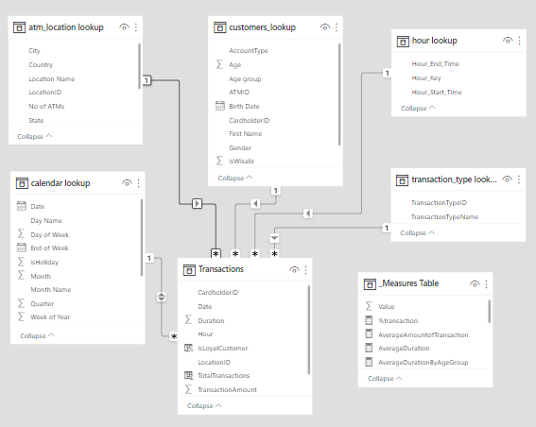
Relationship between tables:
The relationship between tables are auto created by powerbi. However this can be manually altered just by dragging and dropping a attribute from a table onto the matching attribute of another table in the model view of powerbi.
The relationship can be either one to many or one to one or many to many which are either unidirectional or bidirectional. By default powerbi creates unidirectional relation with one to many.
We manually created many to one unidirectional relationship between created “Date” column in transactions table with Date column in Calender table and Hour in Hour lookup table with hour in transactions table.

Slide 13
4.Framing Potential business questions
Based on the main problem statement , multiple business questions are framed and insights for those are identified with appropriate visual charts and graphs.
1.What is the average transaction amount per customer? Are there any significant variations based on factors such as location, gender, or account type?
2.Which locations have the highest number of ATMs, and do they align with the areas of high customer traffic?
3.Are there any specific transaction types that are more popular among customers? Can we identify patterns or trends in transaction types based on demographics or time of day?
4.How frequently do customers use the ATMs? Are there any specific days or months with increased activity?
5.Are there any noticeable patterns in ATM usage based on the customer's age or occupation?
6.How many transactions occur during peak hours? Are there any specific transaction types that dominate during these.
7.Are there any differences in transaction patterns between weekdays and weekends?
8.Are there any customers with a high number of transactions or large transaction amounts? Can we identify any loyalty or VIP customers based on their ATM usage?
9.Can we identify any correlations between the transaction type and age of customer?
10.Are there any specific locations where the ATM usage is consistently high or low? Can we identify any factors (e.g., city, state, country) that contribute to this pattern?

Slide 14
11.What is the average number of ATMs available per location? Are there any locations where the number of ATMs is inadequate or excessive compared to customer demand?
12.Are there any cardholders who frequently use multiple ATMs? Can we identify any patterns in their transaction behavior or demographic characteristics?
13.Can we identify any correlations between the transaction duration (start and end datetime) and factors such as transaction type, location, or cardholder demographics?
14.Can we determine if there is any relationship between the transaction type and the account type (e.g., personal, business) of the cardholders?
15.What is the average transaction amount by location and transaction type? For each occupation?
16.Which ATM location has the highest number of transactions per day, and at what time of the day do the transactions occur most frequently?
17.What is the trend of transaction volume and transaction amount over time, and are there any seasonal trends or patterns?
18.What is the most common transaction type, and how does it vary by location, time of day and customer type ( Wisabi customer vs. non-Wisabi customer)?
19.What is the average transaction frequency per customer by occupation and age group?
20.What is the distribution of transaction amounts and transaction frequency, and are there any outliers?
21.Which ATM locations have the highest and lowest utilization rates, and what factors contribute to this utilization rate?
22.What is the average transaction time taken by time of day and how does it vary by customer type and occupation?
23.Show the detailed transactions split in percentage.
24.Create an interactive bubble chart that visually represents the average transaction amount, average duration, and total number of transactions for each day and location
Click for insights

Slide 15
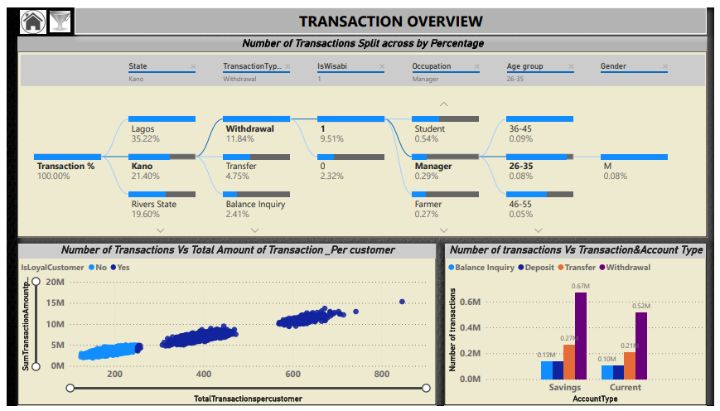
6.Dashboards creation

Slide 16
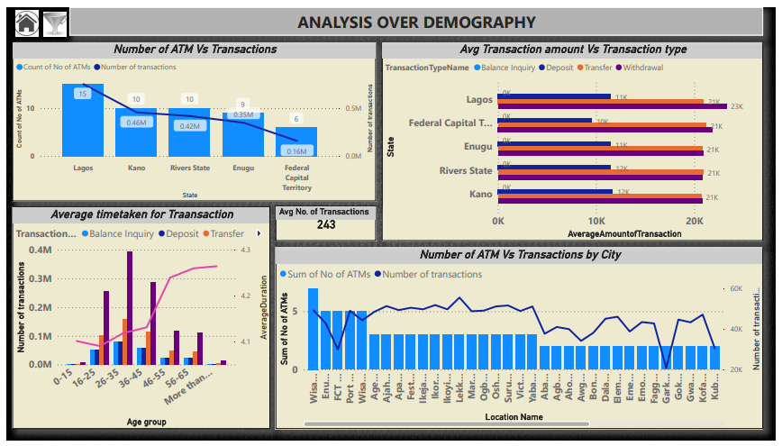

Slide 17
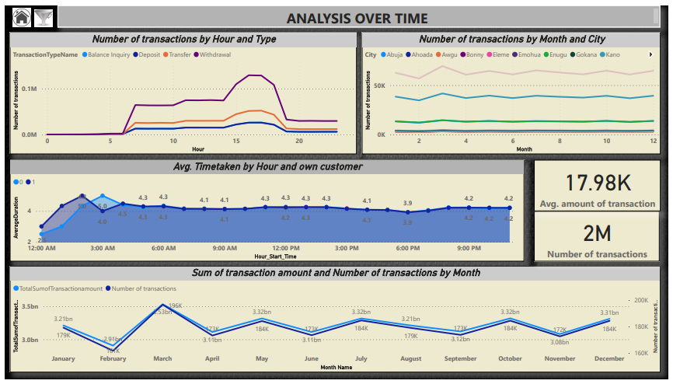

Slide 18
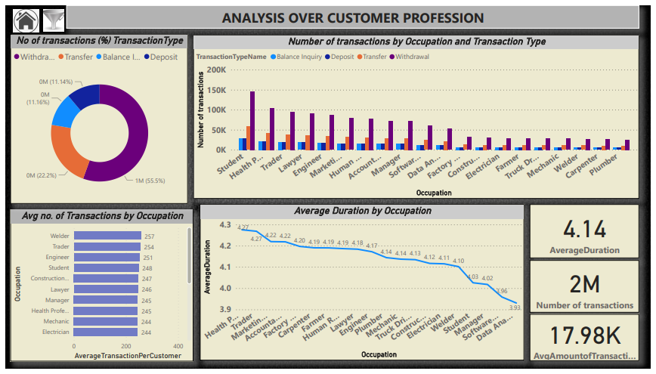

Slide 19
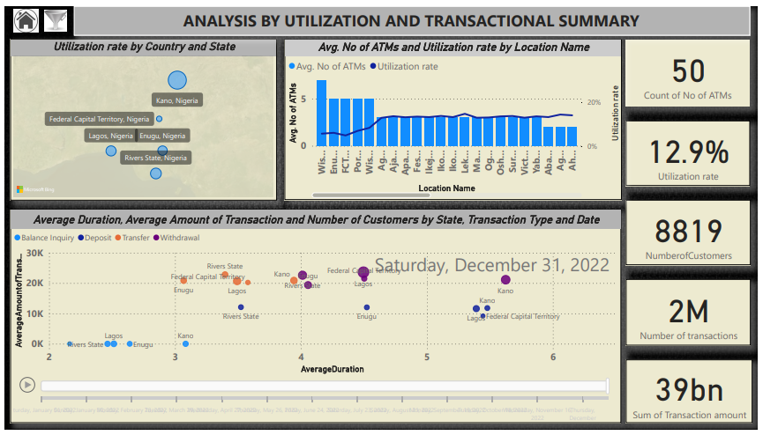

Slide 20
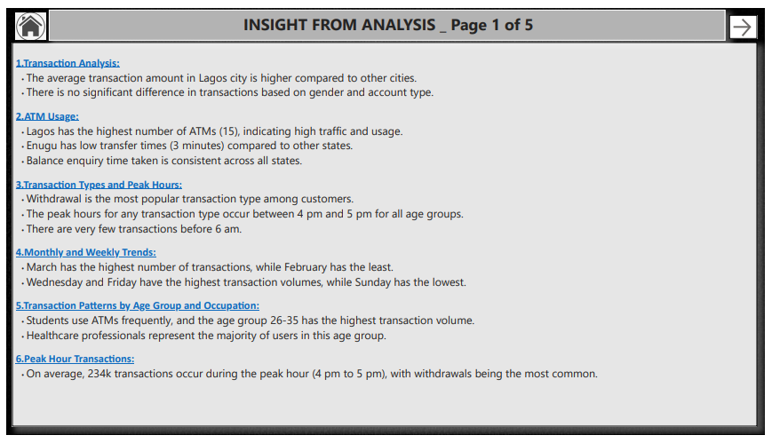
7.Presenting Insights

Slide 21
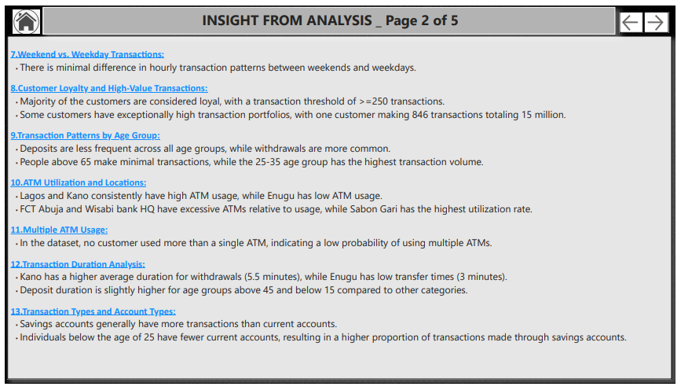

Slide 22
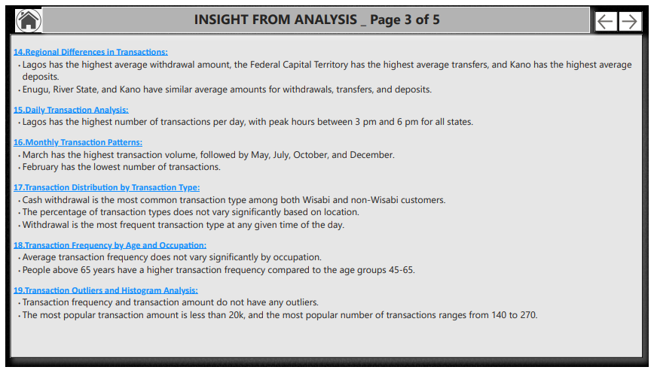

Slide 23
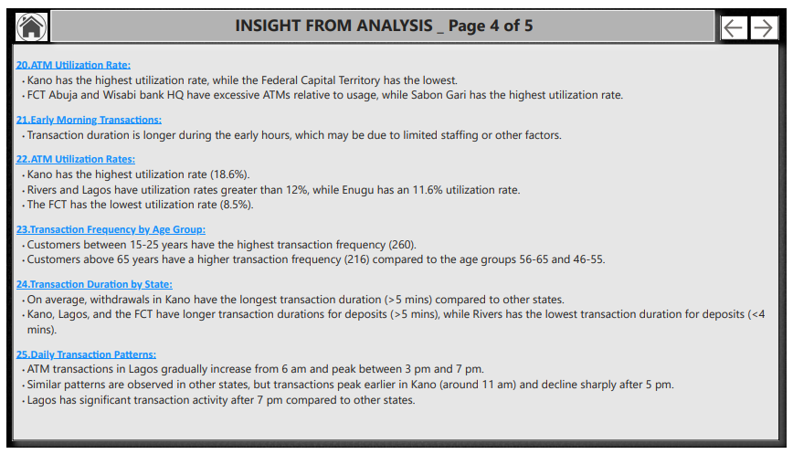

Slide 24
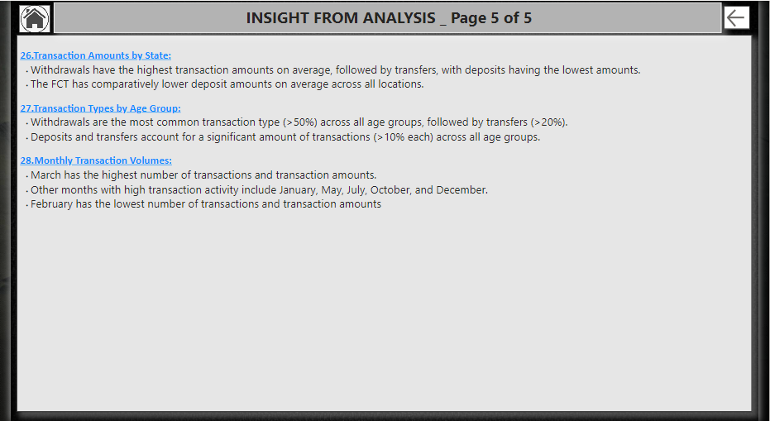

Slide 25
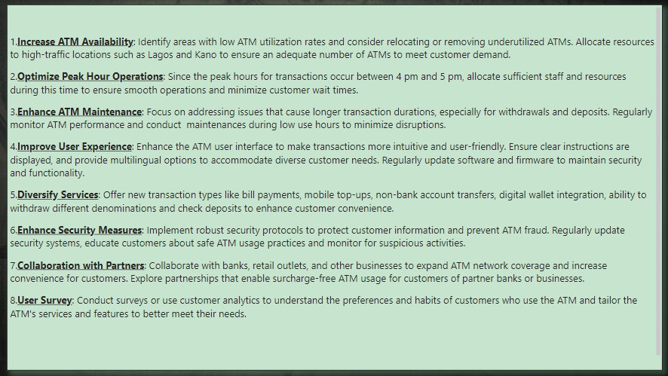
8.Recommendations
Link to Project reports and files :https://drive.google.com/drive/folders/1bVi-Dx85QPtc4shRtKHUBo7oeabUB1aZ

